Slide 1


Durhide
Ryan Collins
Mike croall
Thomas lafferty
Oliver mcleod

Slide 2

The big idea
18 Traffic Cameras around Durham with related images updating every minute.
Designed an app that shows the position and orientation of the cameras on a map.
Players must travel across Durham avoiding detection using the pictures provided by the camera or, for less of a challenge, regions designated dangerous on the map.

Slide 3
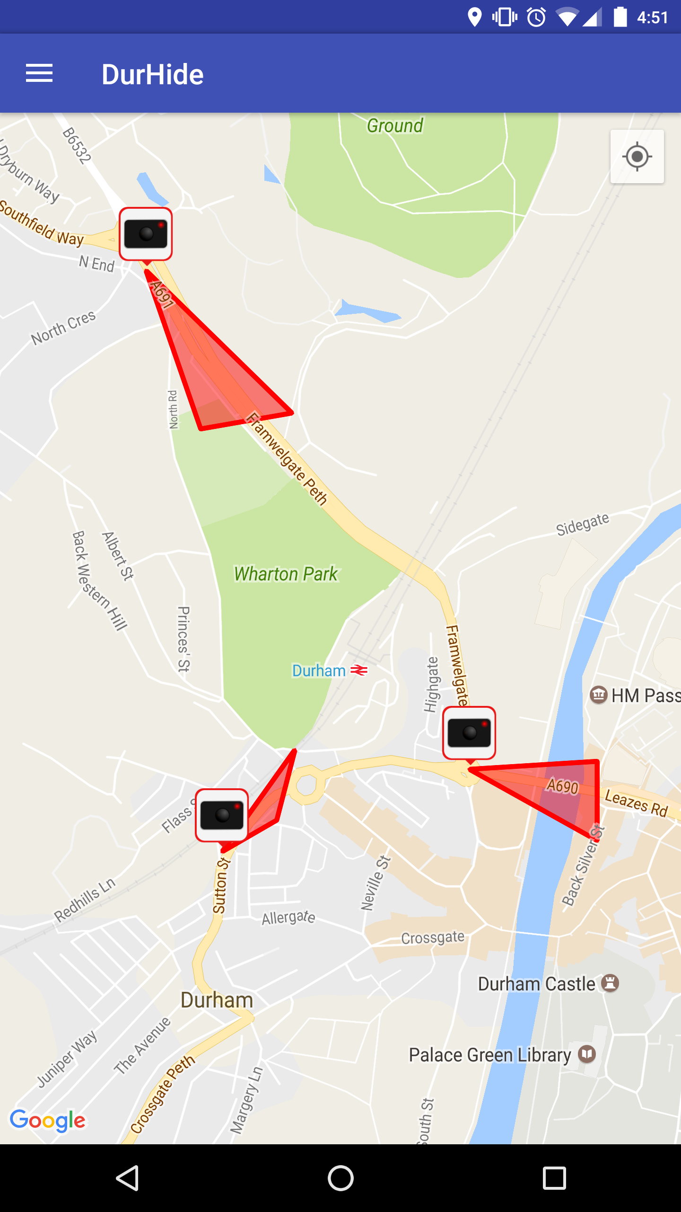
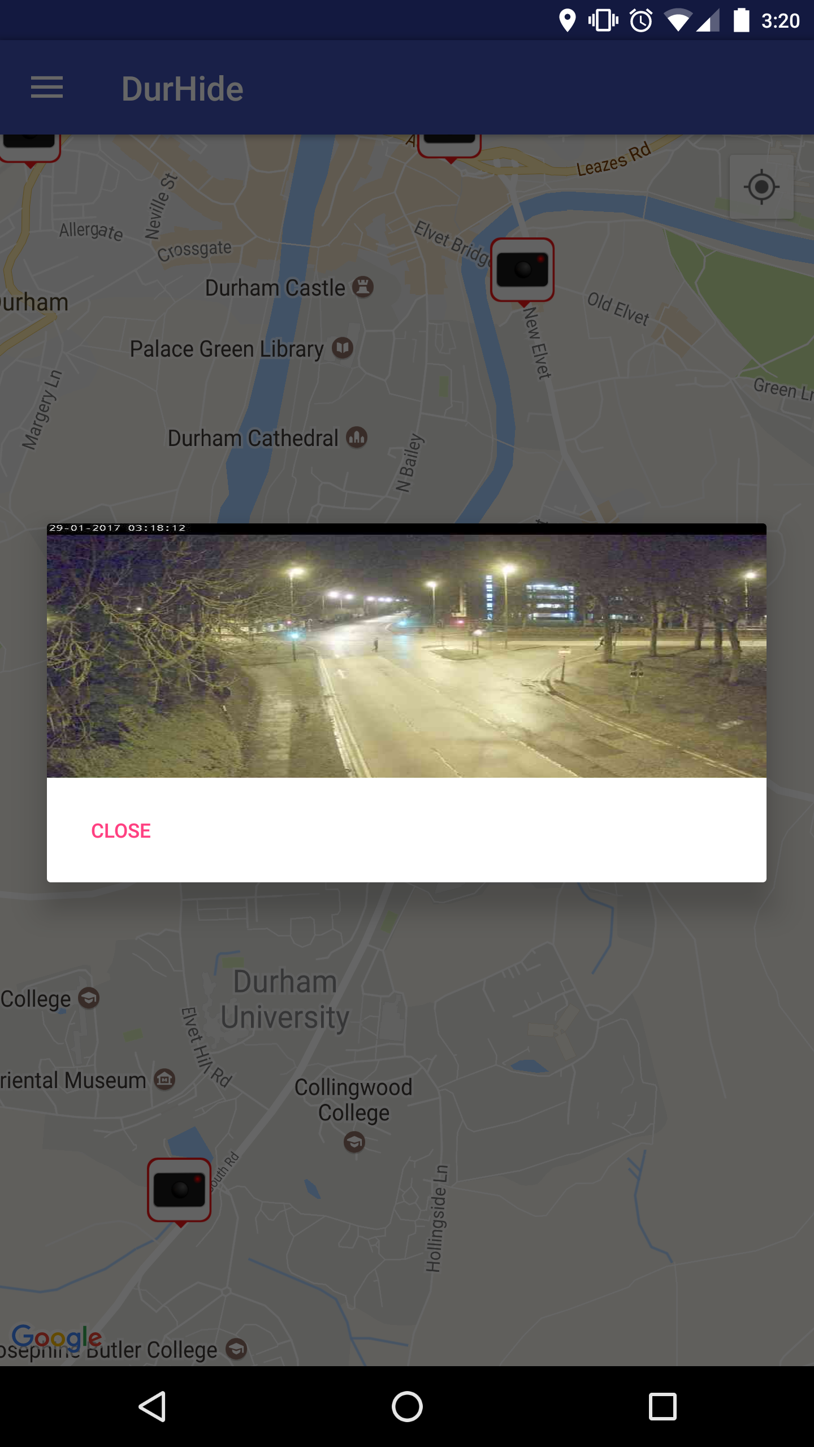
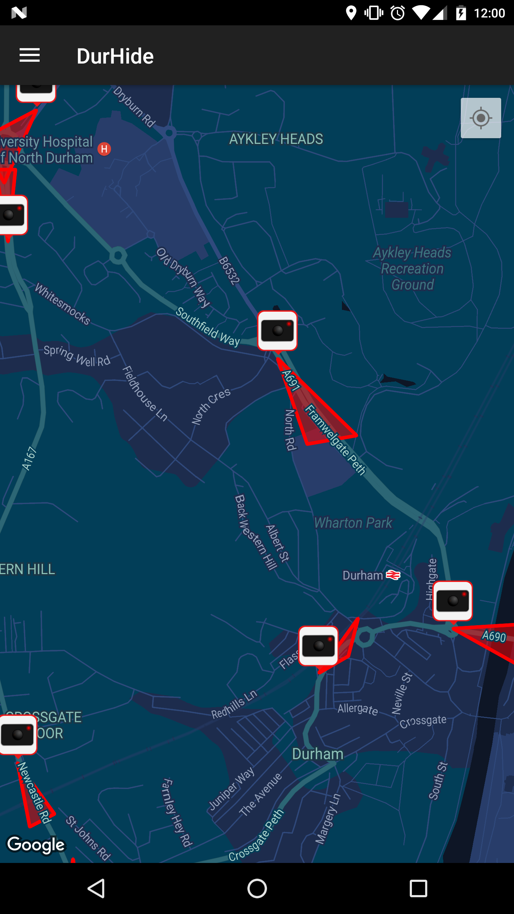
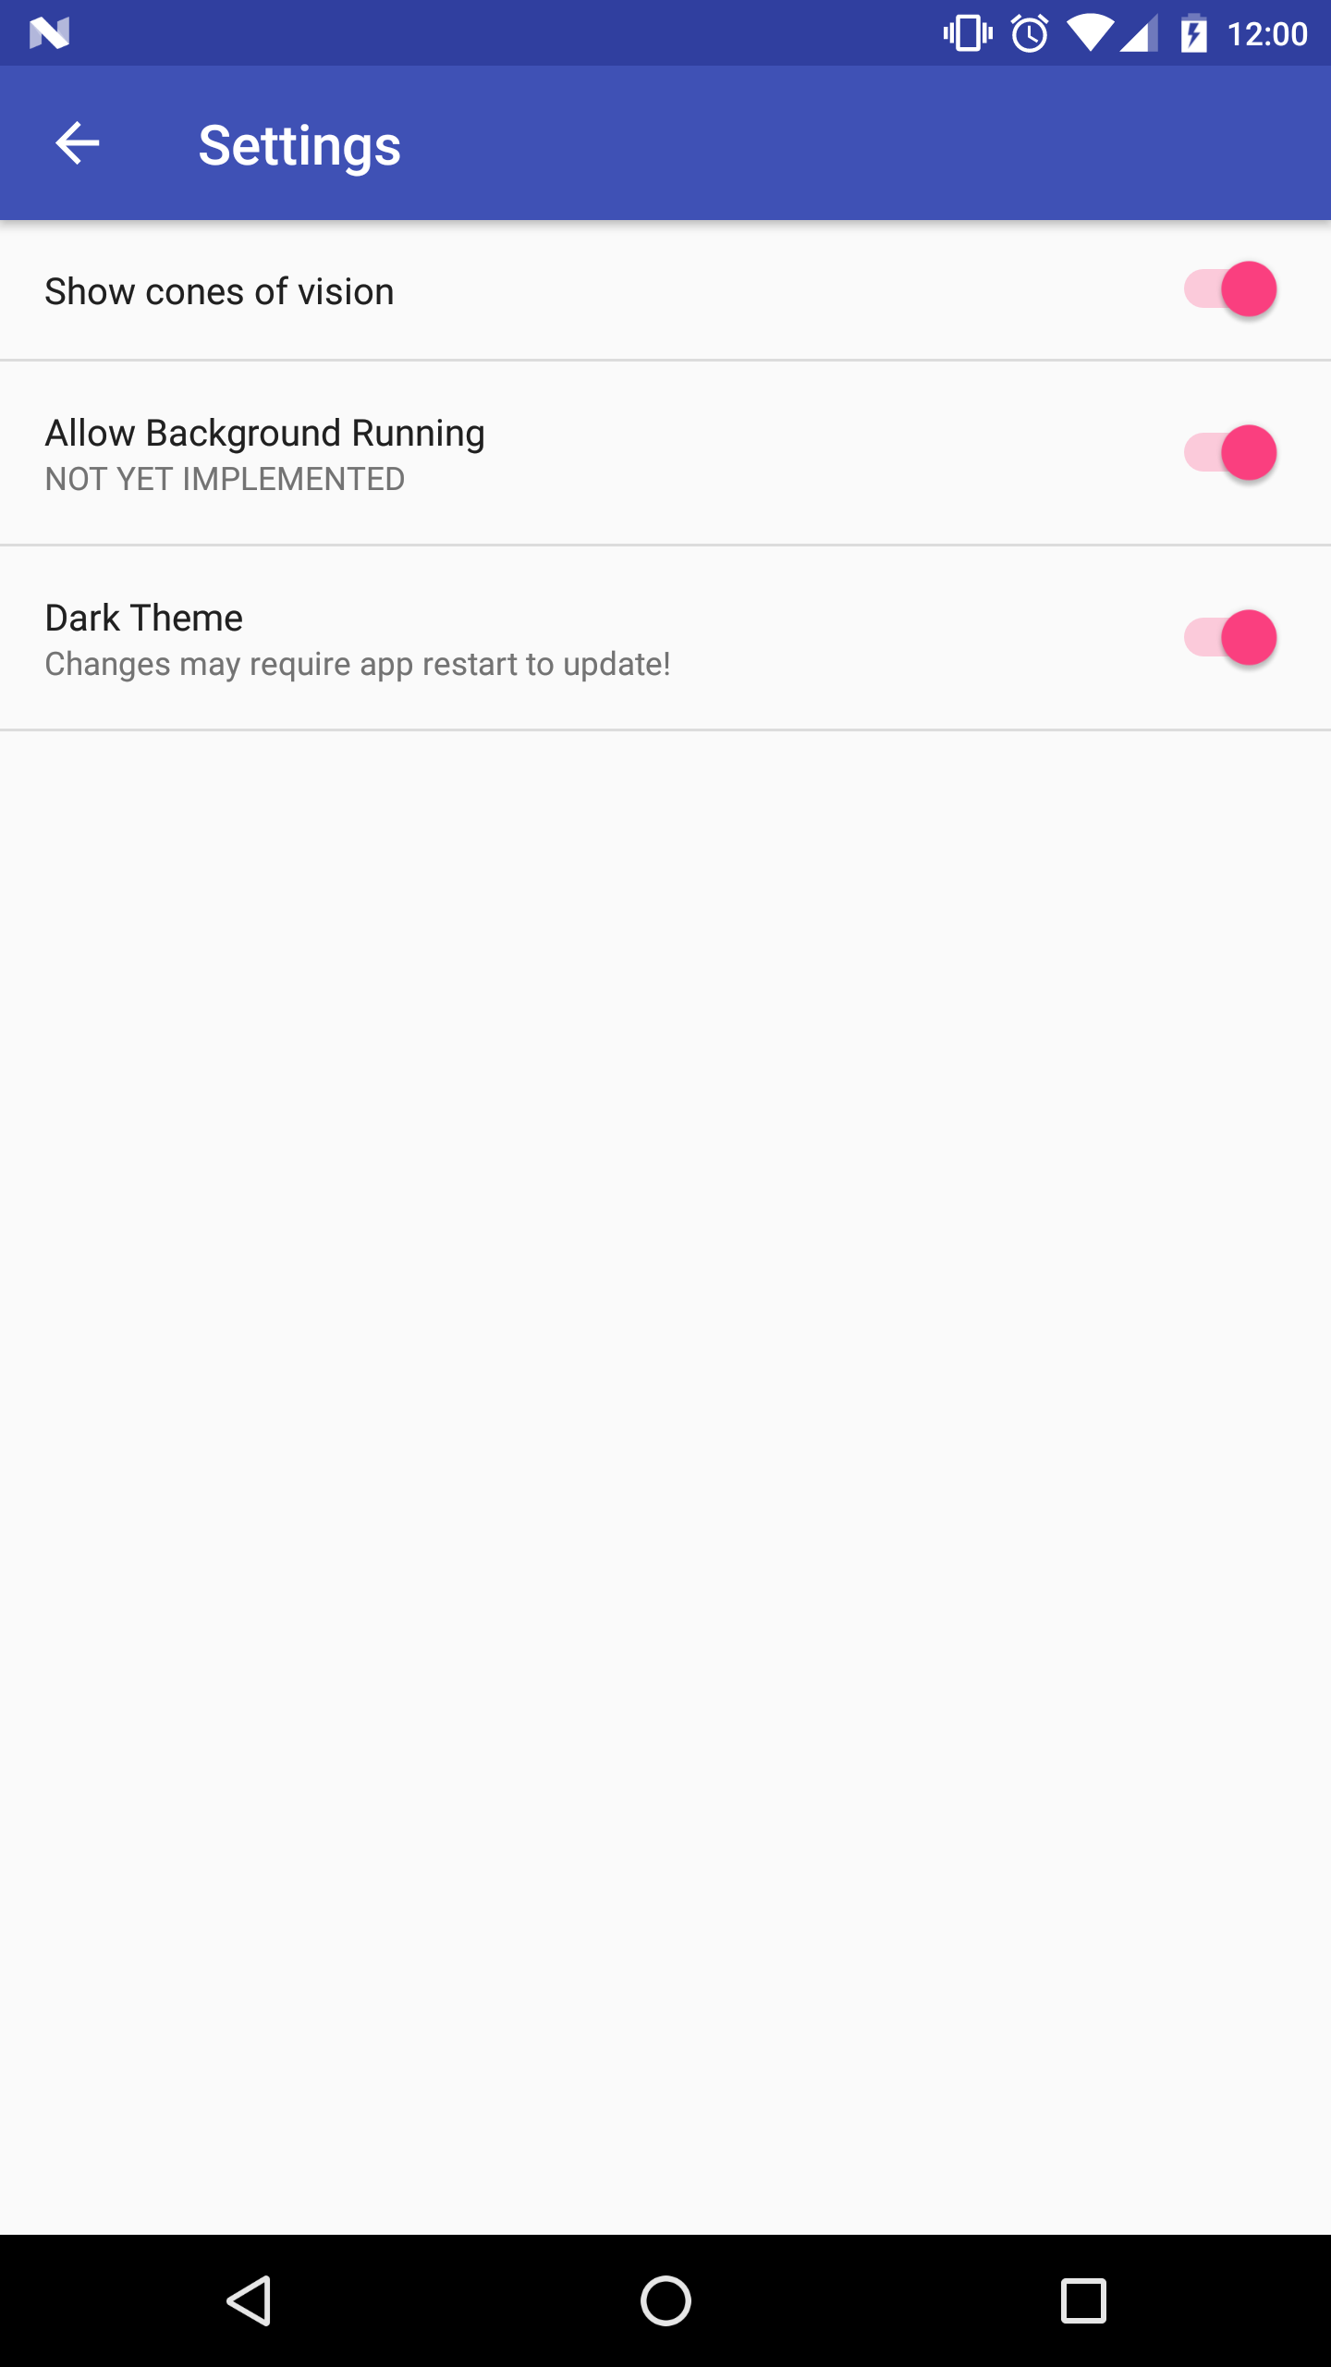
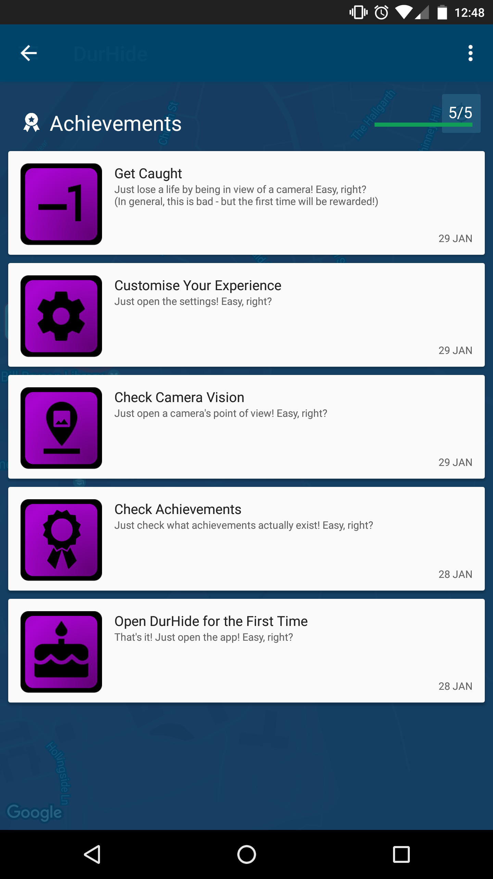
The product
Normal Map
Camera View
Night Mode
Settings
Achievements

Slide 4

Implementation
Looks like this

Slide 5
Problems
UTM to Long. and Lat.
OAuth bants
Images wider than Britain
Geofencing
New Technologies
Android studio auto generating deprecated methods
Settings bar juggling
Adverse weather conditions
Toms Laptop
Ryan Collins
RIP John Jennings

Slide 6

What have you done today?
Ambitious project – proud to have completed it in time
Learnt a lot about stuff and things
Completed on limited sleep - Two idiots were drinking the night before
Looks good (If we do says so ourselves)
(TO MAKE YOU FEEL PROUD)

Slide 7

The future of durhide
Alternative game modes – perhaps get seen as much as possible (Safety Mode)
More Achievements
More Graphics
Support for more cities and areas.
Take over the world

